Slide 1
UX Document
Scenario for Humax Privacy Policy and Terms and Conditions
23 June, 2015
HUMAX

Slide 2
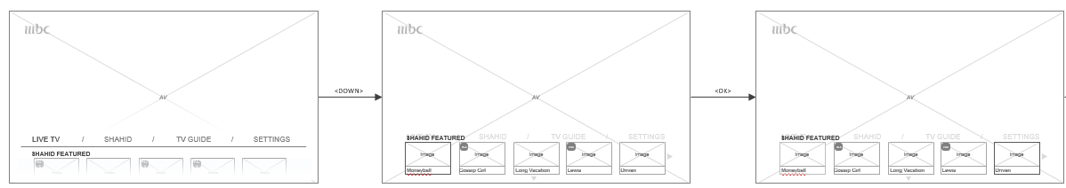
Summary
1. M1 제품에서 Privacy Policy, Terms & Conditions 동의 후 이용할 수 있는 서비스는 하기와 같다.
1) Shahid Service: Shahid Application, Home>Shahid Featured
2) User log based recommendation service: Home> Top Channels
2. Privacy Policy, Terms & Conditions 가 출력되는 영역은 하기와 같다.
1) 최초 인터넷이 연결된 경우
Installation Wizard 단계에서 인터넷이 연결되면 출력된다. (Go to Page 3~5)
하지만 Installation Wizard 단계에서는 미연결되어 추후에 연결될 경우에는 Home> Shahid Featured / Top Channels 혹은 Shahid Application 진입 시에 최초로 출력된다. (Go to
2) 이전에 Privacy Policy, Terms & Conditions 에 하나라도 동의하지 않은 상태에서, 상기의 서비스를 이용하고자 할 경우 재출력된다.
3) Settings> General Settings> Privacy Policy, Terms & Conditions 항목에서 출력된다.

Slide 3
Installation Wizard

Slide 4
Work Flow
Installation Wizard 에서 Work Flow는 다음과 같이, Network Connection 성공 여부 확인 되면 Privacy Policy, Terms & Conditions 화면이 출력되며, 성공하지 않으면 출력되지 않고 바로 Channel Search가 출력된다.
LANGUAGE SELECTION
Internet
connected?
Network password
required?
WELCOME
Select
[START NOW]
COUNTRY SELECTION
Wireless network
AP list
No
or
SKIP
START
No
NETWORK CONNECTION
Yes
Yes
WLAN
Connected?
Valid
password?
Results
Channel Search
Check and select [NEXT]
PRIVACY POLICY, TERMS & CONDITIONS
Password input
[FINISH]
Yes
&[NEXT]
Yes
No
No
The first channel will be tuned

Slide 5
Installation Wizard > PRIVACY POLICY, TERMS & CONDITIONS
Installation Wizard 에서 Network Connection 성공 후에 출력되는 화면은 다음과 같다.
NO
DESCRIPTION
1
PRIVACY POLICY, TERMS & CONDITIONS
2
>>>>
Text: “PRIVACY POLICY, TERMS & CONDITIONS”
Icon: Status Indicator
Text: “PRIVACY POLICY”
Button for Scroll
Check box + Text “I agree to the Privacy Policy.”
Text: “TERMS & CONDITIONS”
Button for Scroll
Check box + Text “I agree to the Terms & Conditions.”
Button: <PREVIOUS>, <NEXT> (Default cursor)
STR_MESG_5878_ID
PRIVACY POLICY
TERMS & CONDITIONS
3
6
4
7
This Privacy Policy applies to all information collected by HUMAX Co., Ltd. and any member of the HUMAX group (“We” or “Humax”) via Humax set top box or OTT device (“Product”) or Humax services available on the Product (“Services”).
How to contact us about privacy
Your privacy is very important to us. For that reason, please read the following details carefully and get in contact with us if you have any questions or concerns regarding this Privacy Policy. Please
This Privacy Policy applies to all information collected by HUMAX Co., Ltd. and any member of the HUMAX group (“We” or “Humax”) via Humax set top box or OTT device (“Product”) or Humax services available on the Product (“Services”).
How to contact us about privacy
This Privacy Policy applies to all information collected by HUMAX Co., Ltd. and any member of the HUMAX group (“We” or “Humax”) via Humax set top box or OTT device (“Product”) or Humax services available on the Product (“Services”).
How to contact us about privacy
Your privacy is very important to us. For that reason, please read the following details carefully and get in contact with us if you have any questions or concerns regarding this Privacy Policy. Please
This Privacy Policy applies to all information collected by HUMAX Co., Ltd. and any member of the HUMAX group (“We” or “Humax”) via Humax set top box or OTT device (“Product”) or Humax services available on the Product (“Services”).
How to contact us about privacy
STR_PRIVACY_POLICY_02_ID
STR_MESG_5862_ID
STR_TERMS_CONDITIONS_ID
STR_MESG_5880_ID
I agree to the Privacy Policy.
I agree to the Terms & Conditions.
5
v
8
v
9
PREVIOUS
NEXT
Summary
Network 연결 후 [NEXT] 버튼을 누르면 위와 같은 동의안이 출력된다.
Check Box에는 Default로 체크표시가 되어 있으며, <OK>key 선택 시 체크표시가 해제된다.
<NEXT> 버튼에 default cursor 가 위치한다.
<UP>/<DOWN> key 의 Navigation Sequence 는 다음 페이지에서 설명한다.

Slide 6
한번도 출력되지 않거나, 미동의한 상태에서 Service 이용 시도 시

Slide 7
한번도 출력되지 않거나, 미동의한 상태에서 Service 이용 시도 시
한번도 출력되지 않거나, 미동의한 상태에서 Service 이용 시도 시 하기와 같은 화면이 출력된다.
NO
DESCRIPTION
DESCRIPTION
PRIVACY POLICY, TERMS & CONDITIONS
Text: “DONE”
이하 Page 5 의 Installation Wizard와 동일함.
PRIVACY POLICY
TERMS & CONDITIONS
This Privacy Policy applies to all information collected by HUMAX Co., Ltd. and any member of the HUMAX group (“We” or “Humax”) via Humax set top box or OTT device (“Product”) or Humax services available on the Product (“Services”).
How to contact us about privacy
Your privacy is very important to us. For that reason, please read the following details carefully and get in contact with us if you have any questions or concerns regarding this Privacy Policy. Please
This Privacy Policy applies to all information collected by HUMAX Co., Ltd. and any member of the HUMAX group (“We” or “Humax”) via Humax set top box or OTT device (“Product”) or Humax services available on the Product (“Services”).
How to contact us about privacy
This Privacy Policy applies to all information collected by HUMAX Co., Ltd. and any member of the HUMAX group (“We” or “Humax”) via Humax set top box or OTT device (“Product”) or Humax services available on the Product (“Services”).
How to contact us about privacy
Your privacy is very important to us. For that reason, please read the following details carefully and get in contact with us if you have any questions or concerns regarding this Privacy Policy. Please
This Privacy Policy applies to all information collected by HUMAX Co., Ltd. and any member of the HUMAX group (“We” or “Humax”) via Humax set top box or OTT device (“Product”) or Humax services available on the Product (“Services”).
How to contact us about privacy
I agree to the Privacy Policy.
I agree to the Terms & Conditions.
v
v
DONE
1
Summary
[DONE] 선택 시 창 닫힘.

Slide 8
Settings

Slide 9
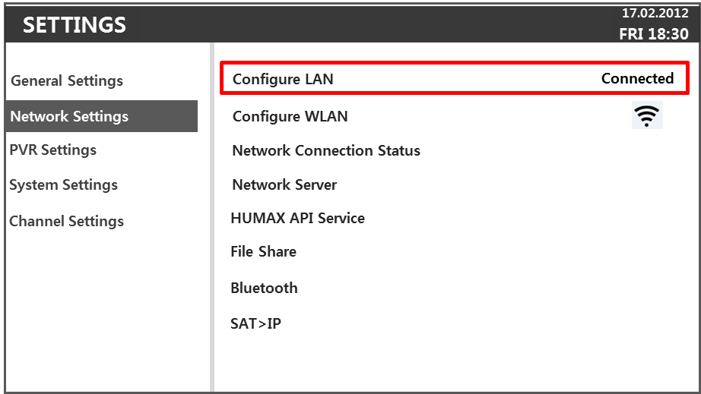
General Settings > Privacy Policy and Terms and Conditions
NO
DESCRIPTION
Parental Control
Language
Video
Audio
On-Screen Display
Privacy Policy, Terms and Conditions
Text
Network Settings
Privacy Policy, Terms and Conditions
STR_MESG_5881_ID
이하 Page 5 의 Installation Wizard와 동일함.
1
PRIVACY POLICY, TERMS & CONDITIONS
PRIVACY POLICY
TERMS & CONDITIONS
This Privacy Policy applies to all information collected by HUMAX Co., Ltd. and any member of the HUMAX group (“We” or “Humax”) via Humax set top box or OTT device (“Product”) or Humax services available on the Product (“Services”).
How to contact us about privacy
Your privacy is very important to us. For that reason, please read the following details carefully and get in contact with us if you have any questions or concerns regarding this Privacy Policy. Please
This Privacy Policy applies to all information collected by HUMAX Co., Ltd. and any member of the HUMAX group (“We” or “Humax”) via Humax set top box or OTT device (“Product”) or Humax services available on the Product (“Services”).
How to contact us about privacy
This Privacy Policy applies to all information collected by HUMAX Co., Ltd. and any member of the HUMAX group (“We” or “Humax”) via Humax set top box or OTT device (“Product”) or Humax services available on the Product (“Services”).
How to contact us about privacy
Your privacy is very important to us. For that reason, please read the following details carefully and get in contact with us if you have any questions or concerns regarding this Privacy Policy. Please
This Privacy Policy applies to all information collected by HUMAX Co., Ltd. and any member of the HUMAX group (“We” or “Humax”) via Humax set top box or OTT device (“Product”) or Humax services available on the Product (“Services”).
How to contact us about privacy
Summary
인터넷 미연결 시에는, 해당 페이지로 진입되지 않으며, Response message 로 “Check network connection” 제공한다.
I agree to the Privacy Policy.
I agree to the Terms & Conditions.
STR_CHECK_NETWORK_CONNECTION_ID
v
v
DONE

